Slide 1






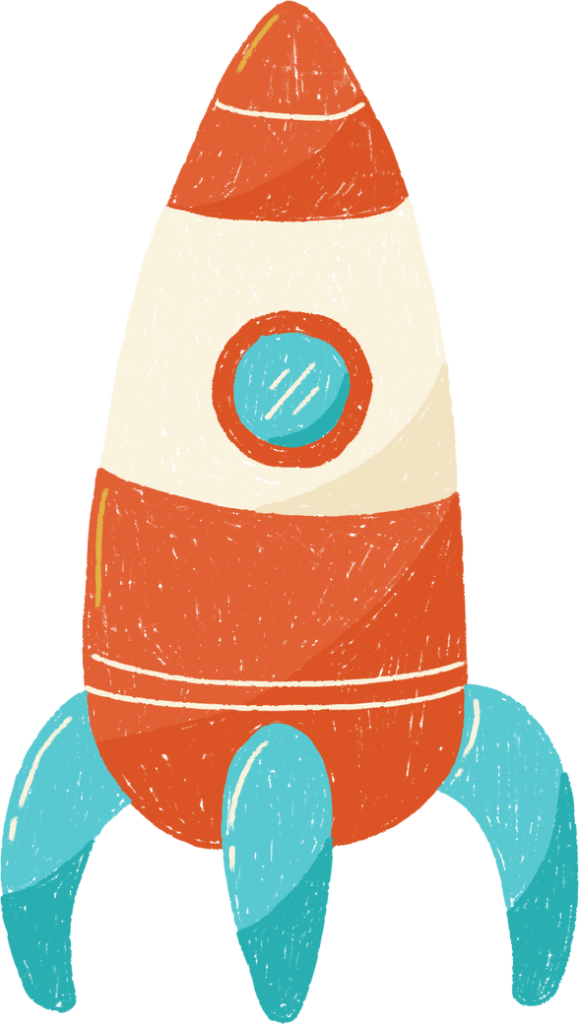





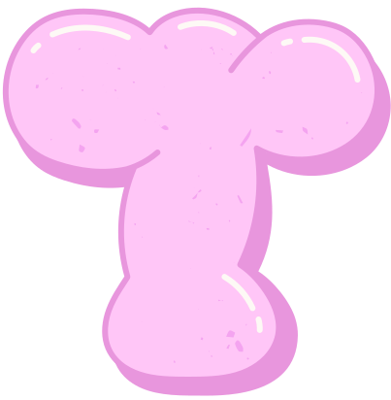




Slide 2





Level 2 - Health -
Lesson 2 - Treatments
Vocabulary
Unit review

Slide 3
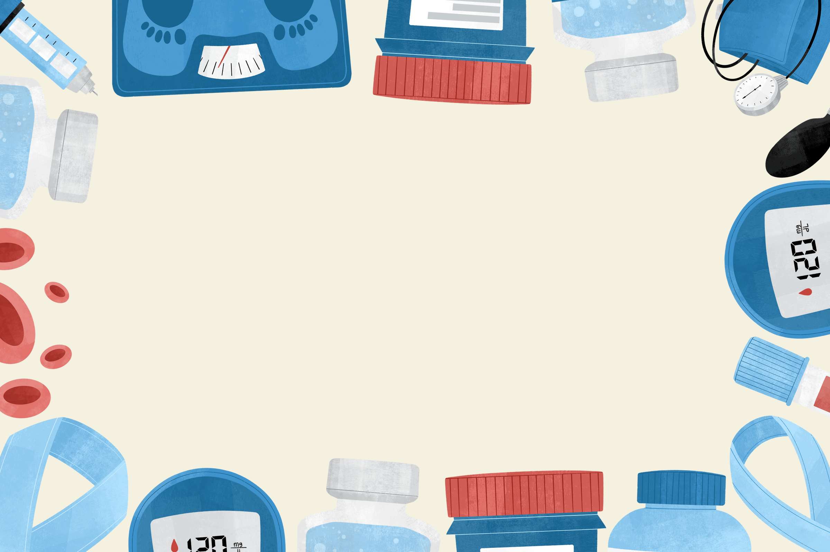





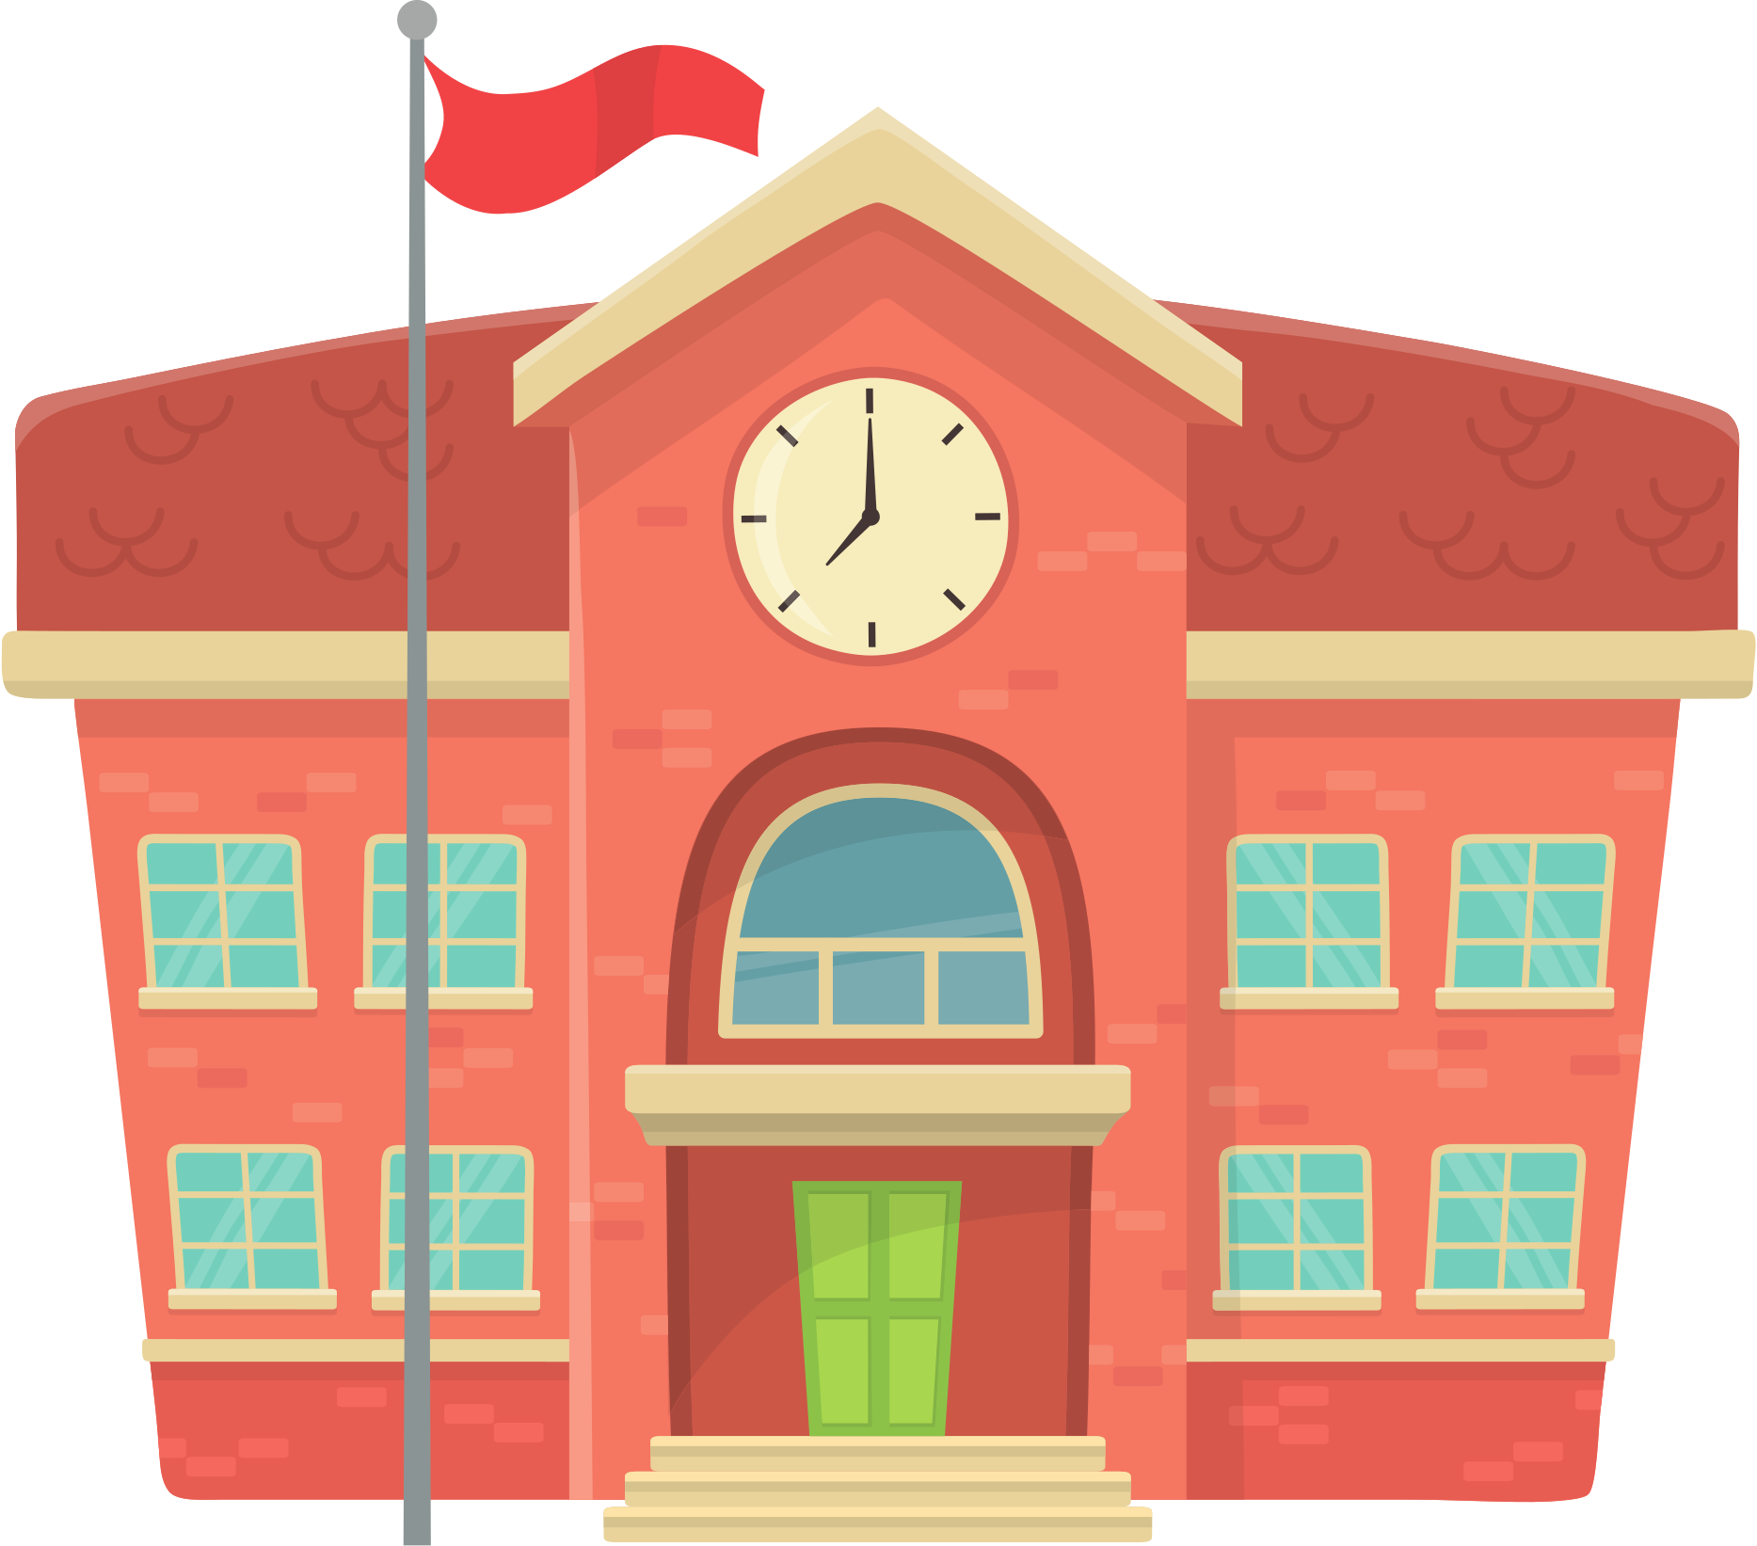



Greeting
Hello, how are you?
I'm
What did you do today?

Slide 4
Introduction
Today we will learn about some illness symptoms!

Slide 5


Review
Let’s review. What illness is this? Can you remember?

Slide 6


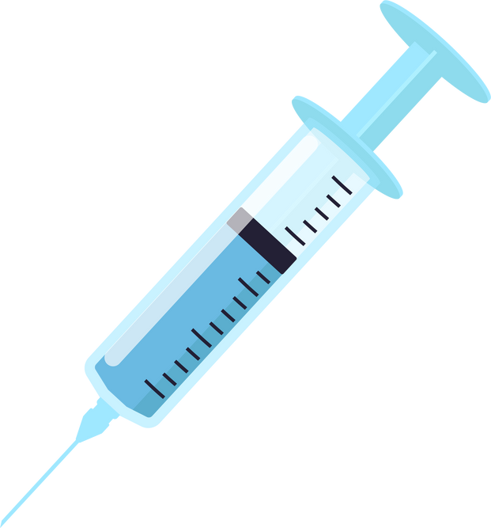
Vocabulary
Treatment
treatments help people get better when they are unwell.
Say and pronounce the word correctly. What is a treatment?

Slide 7
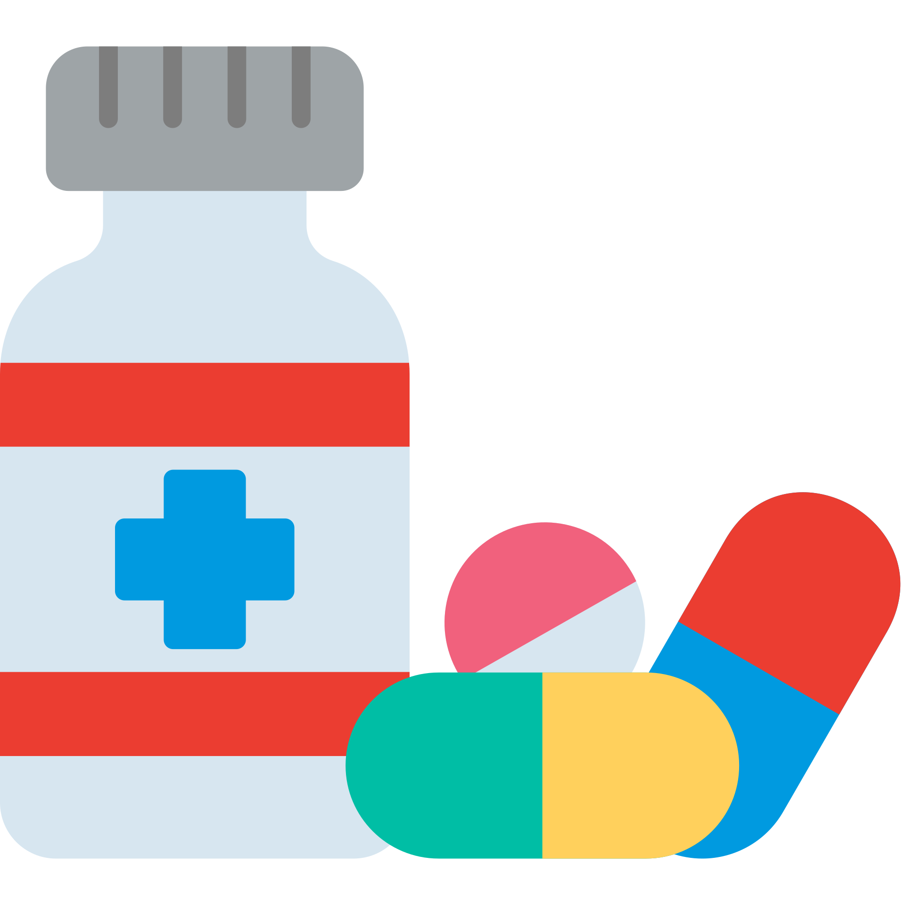
Vocabulary
take some medicine
Say and pronounce the word correctly.
What treatment is this?

Slide 8
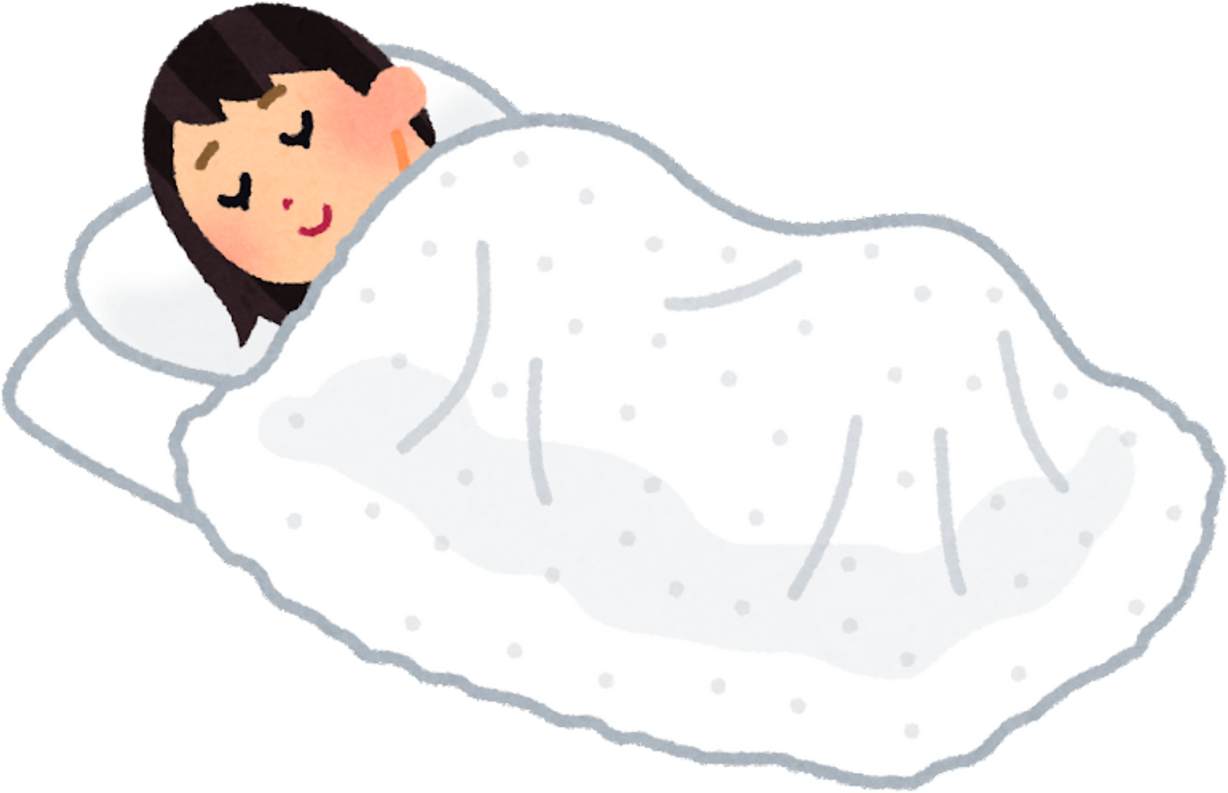
Vocabulary
get some rest
Say and pronounce the word correctly.
What treatment is this?

Slide 9
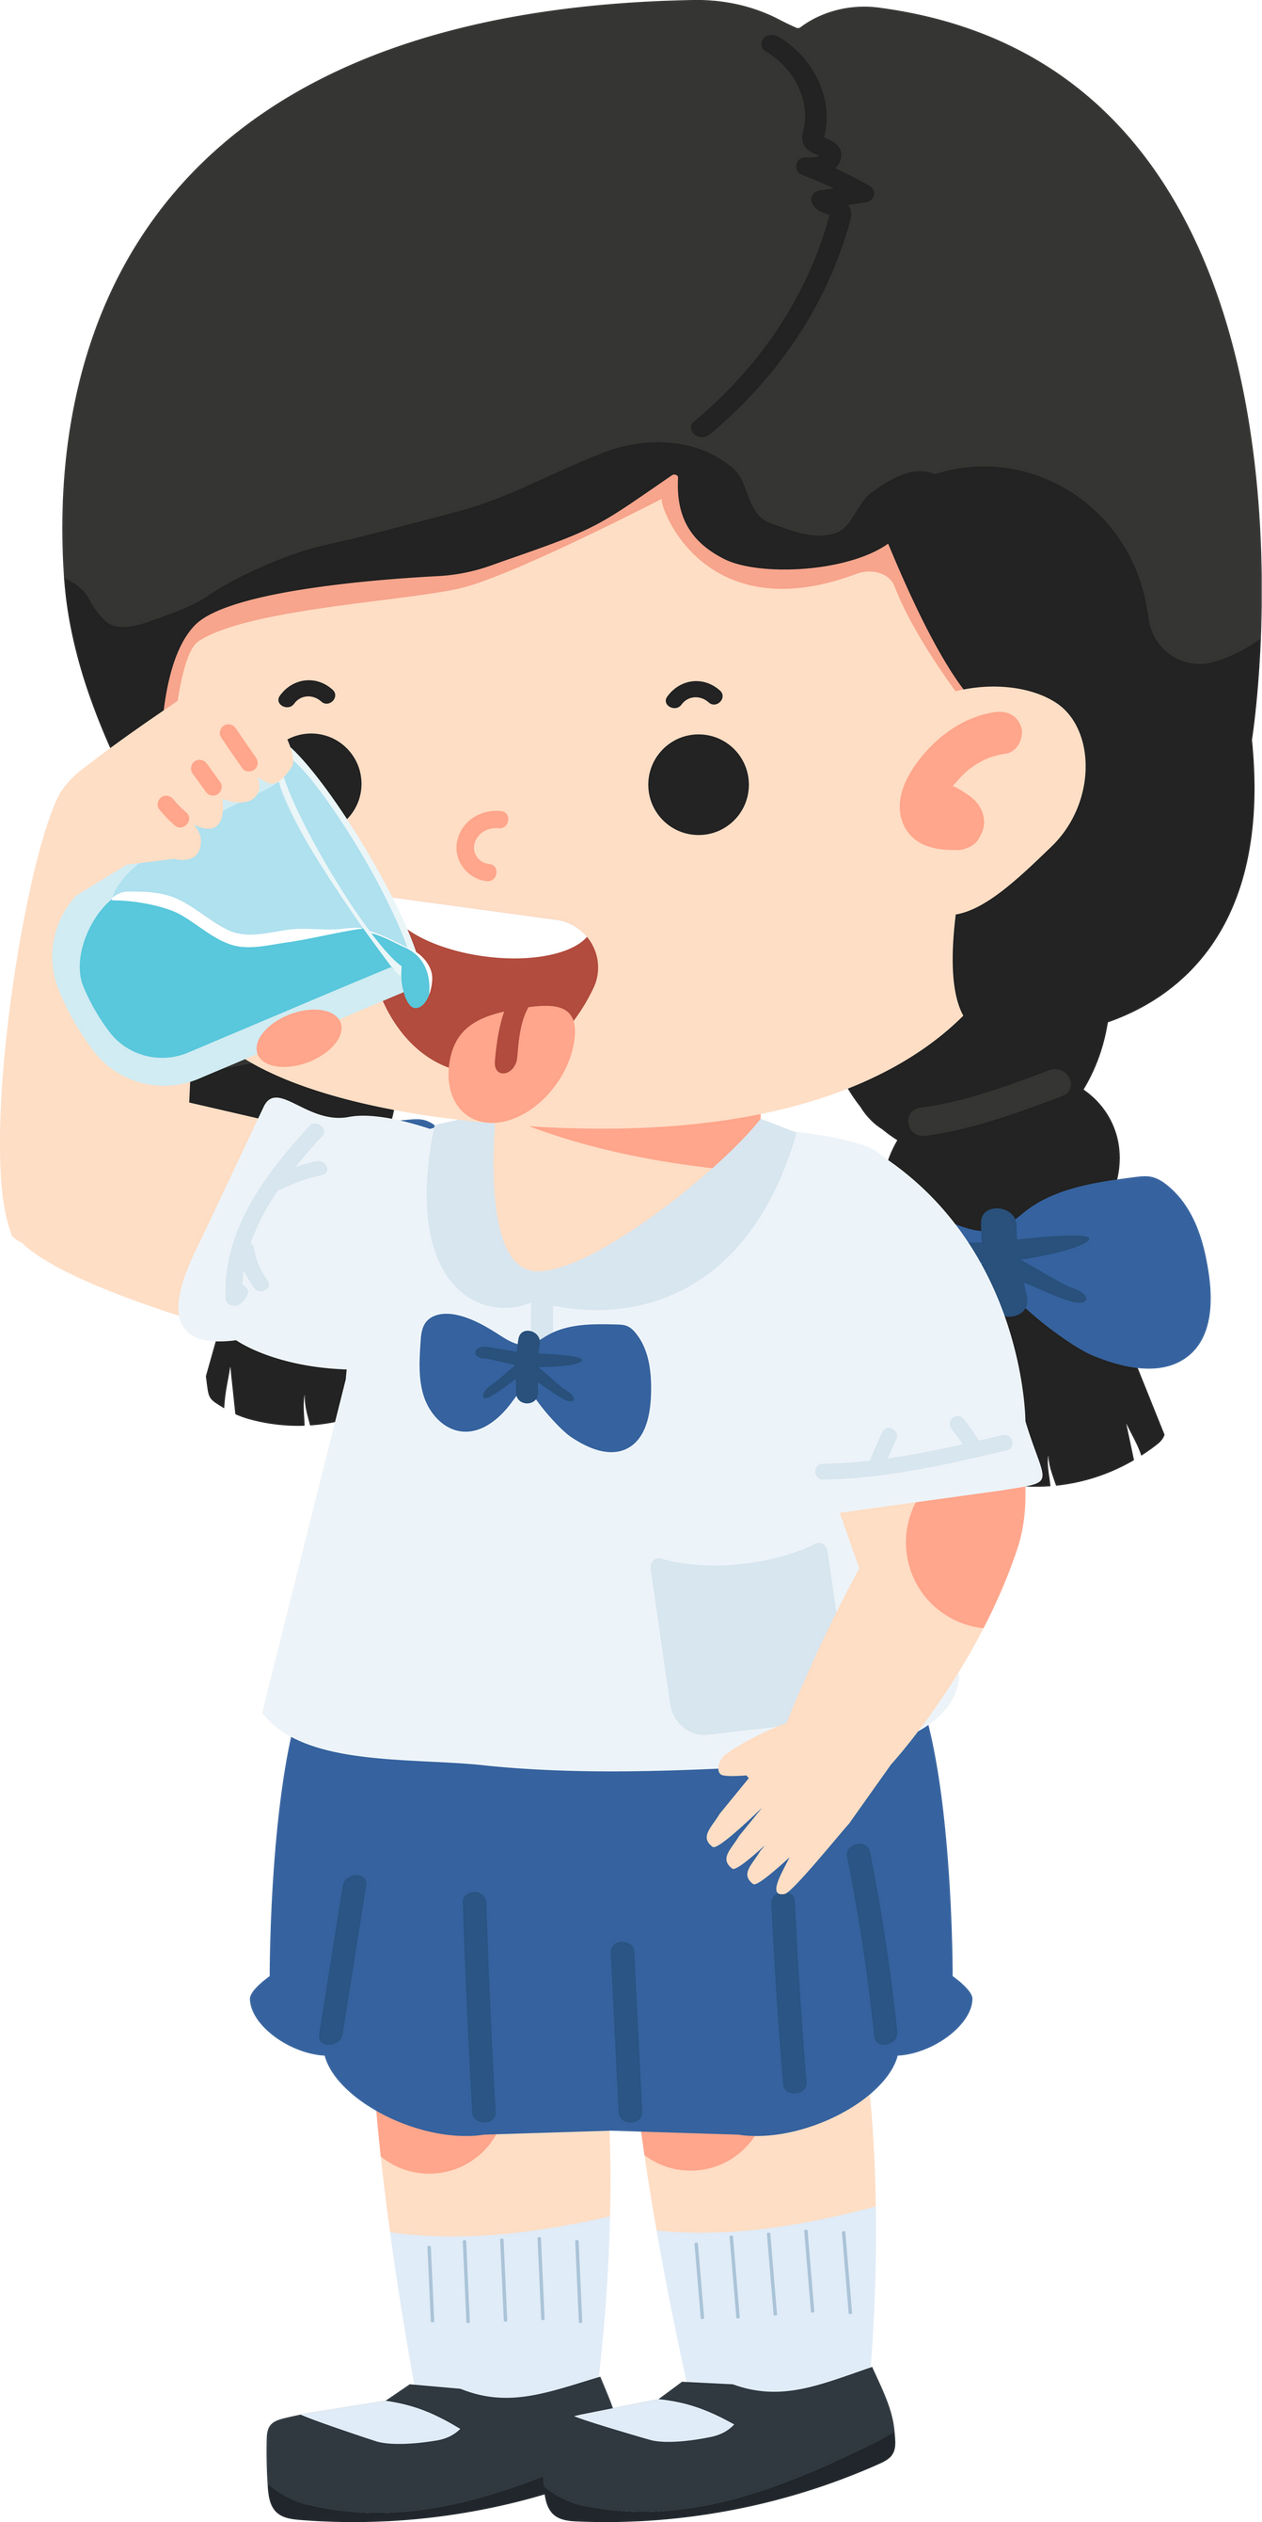
Vocabulary
drink
water
Say and pronounce the word correctly.
What treatment is this?

Slide 10

Vocabulary
drink
herbal
tea
Say and pronounce the word correctly.
What treatment is this?

Slide 11
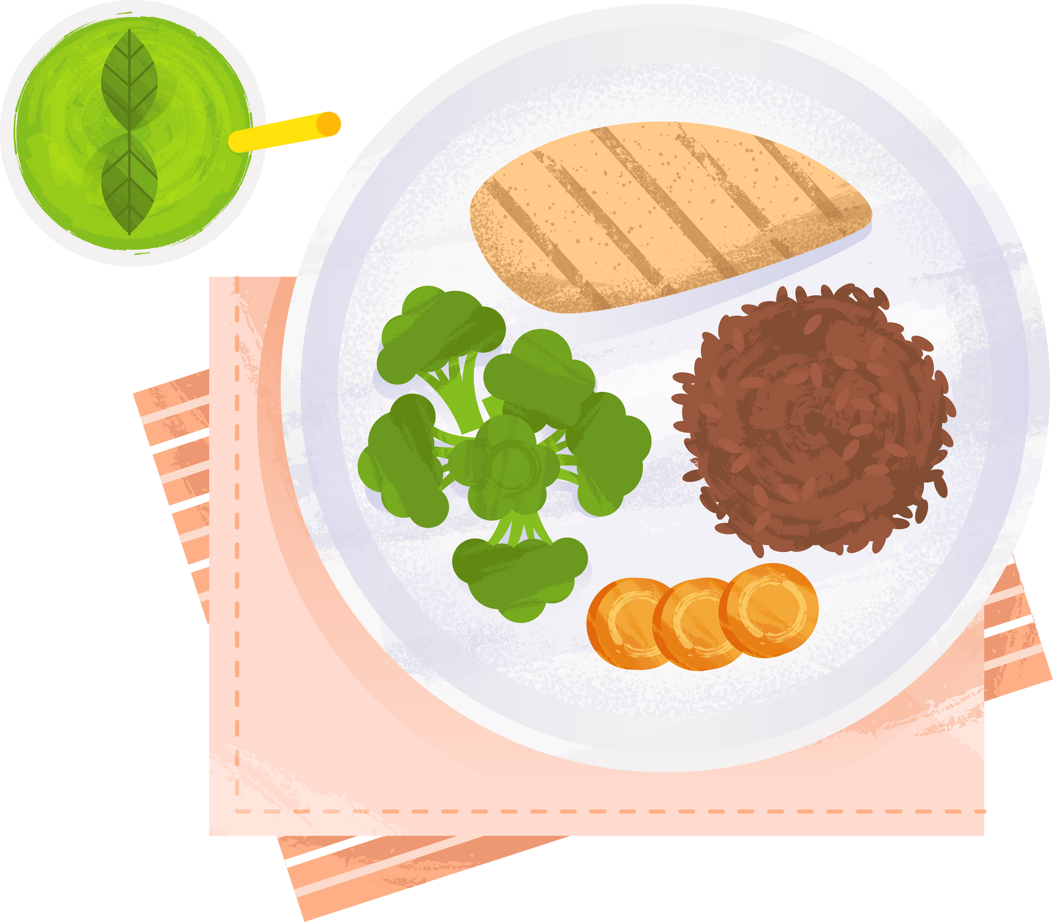
Vocabulary
eat
healthy
foods
Say and pronounce the word correctly.
What treatment is this?

Slide 12
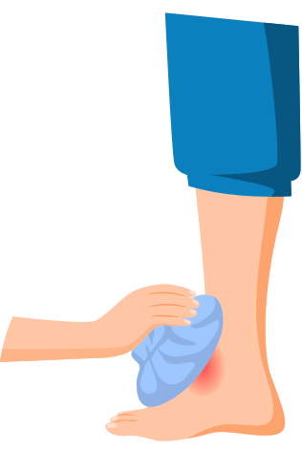
Vocabulary
use a
compress
Say and pronounce the word correctly.
What treatment is this?

Slide 13

Review
Click and guess what treatment you think it is?

Slide 14
Watch
What did you see in the video? “ I saw...”

Slide 15

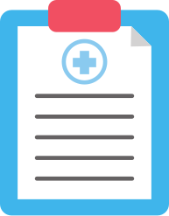
Learning
Let’s give them a treatment!
Can you guess and match the illness and the correct treatment?

Slide 16


Sentence
I suggest
medicine
I have a flu
Repeat the sentences. Pronounce correctly. What is the illness? What is the treatment?

Slide 17
Practice
I suggest
I have a ____
What do you treatment do you suggest for the illness? Circle and say the correct treatments.

Slide 18
Practice
I suggest
I have a ____
What do you treatment do you suggest for the illness? Circle and say the correct treatments.

Slide 19
Practice
I suggest
I have a ____
What do you treatment do you suggest for the illness? Circle and say the correct treatments.

Slide 20
Game
Let’s play snap. click both stars at the same time. When the image is the same shout “snap” and say what it is to win a trophy.

Slide 21


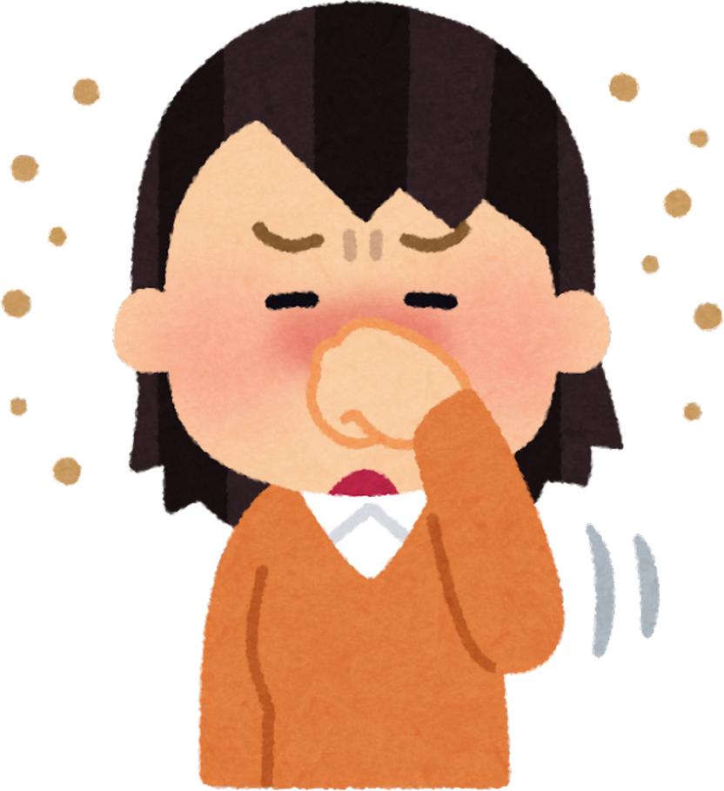
Role Play
Hello, How can I help you?
Doctor
Patient
Hello doctor, I am ill.
What’s the matter?
I have a flu.
I suggest you take medicine.
Thank you, doctor!
Take in turns to be the doctor and the patient.

Slide 22
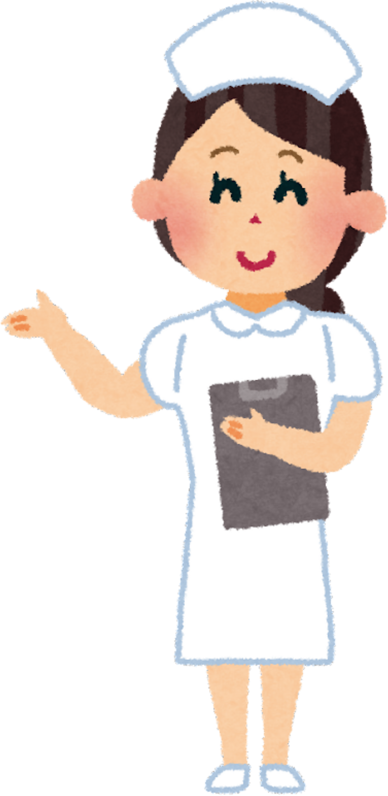
Spelling
What word could it be?
  micineed
2. rtes
3. eentatmtr
4. werat
Can you unscramble the words to get a treatment.

Slide 23
Questions
When did you last get ill?
Do you take medicine when you are unwell?
Do you like to see a doctor?
What is the treatment for a flu?

Slide 24
Board

Slide 25

Goodbye
Goodbye! See you next time.

